Slide 1

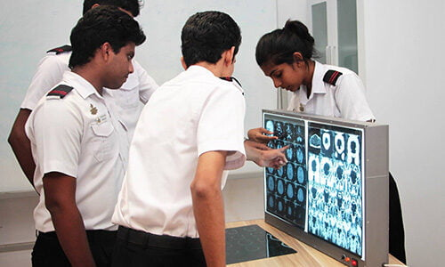
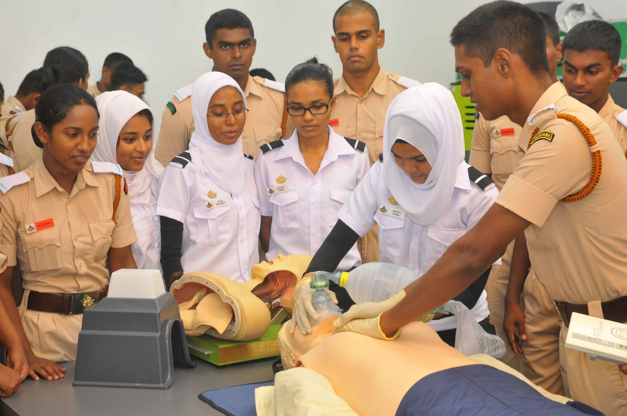
Degree Program Recommendations and Student Satisfaction at KDU
Group 04
22/10/2024

Slide 2
CONTENT
01.Introduction
Importance of student satisfaction
Need for the study
02.Objectives
03.Data Description
04.Methodology
Data Science domains applied
05.Results
Why Python for data analysis
Visualizations
Degree program distribution
Analysis of satisfaction with instruction quality
Common challenges in online learning
Satisfaction with instruction based on gender
Gender Distribution
06.Conclusion
Recommendations for improvement
Impact of recommendations
Recommendations for future work
07.Meet Our Team
08.References
09.Q&A

Slide 3


INTRODUCTION
General Sir John Kotelawala Defence University (KDU) is a leading higher education institution, offering a diverse range of degree programs across multiple disciplines.
The university aims to provide high-quality education while fostering discipline and leadership among students.

Slide 4

Importance of Student Satisfaction
IMPORTANCE OF SATISFACTION
In the competitive landscape of higher education, student satisfaction plays a pivotal role in shaping the institution's reputation and growth.
Satisfied students are more likely to recommend the university, boosting enrollments and improving academic standing.
On the other hand, dissatisfaction can negatively affect retention rates and reputation.

Slide 5

Need for the Study
To secure KDU’s standing as a leading educational institution, it is crucial to understand the primary factors shaping student satisfaction.
Elements such as the quality of teaching, access to academic resources, student support services, and campus infrastructure significantly influence students' overall experience.
Identifying and improving these aspects will help KDU foster a positive learning environment, enhance student well-being, and maintain its competitive edge.

Slide 6

Objectives
Comprehensive Educational Support through a Dedicated Web Page
Interactive Event Calendar and Time Management Tools
User Engagement and Empowerment
Continuous Improvement and Resource Availability

Slide 7
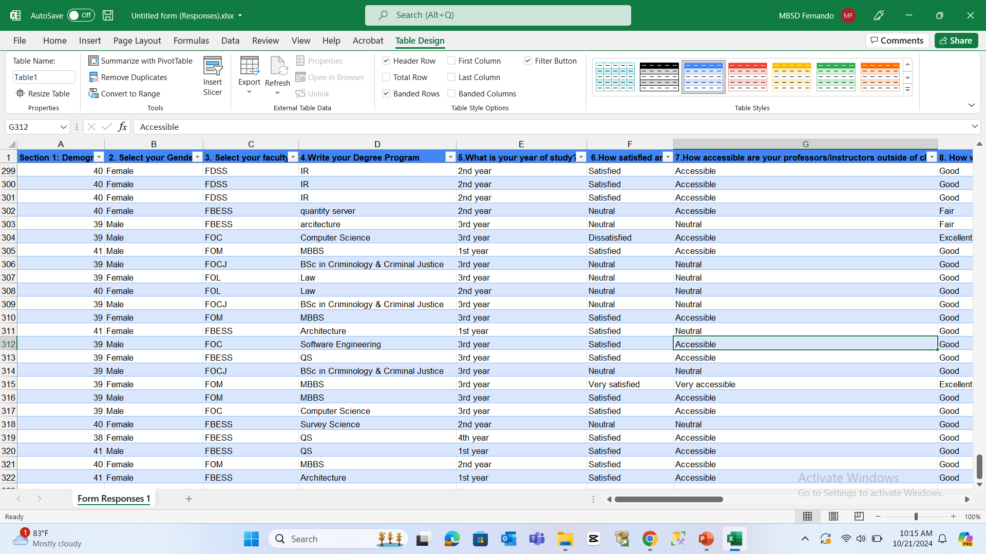
Data Description
Data Source: Collected using Google Forms from 321 respondents.
Data Features (14 columns):
Demographics: Intake, Gender, Faculty, Year of Study.
Instruction Quality: Satisfaction level with teaching and professor accessibility.
Academic Resources: Availability of resources like libraries, online content, and labs.
Support Services: Evaluation of career counseling and academic advising.
Online Learning: Ratings of remote learning experience and challenges faced.
Internet Facilities: Student feedback on campus internet services.
Degree Satisfaction: Overall satisfaction with their degree program.

Slide 8

Methodology
Data Collection Process & DATA PREPARATION
Modeling techniques
Data Analysis
Logistic Regression : These models will give you interpretable results and are easier to explain.
K-Means Clustering to group students based on similar characteristics for deeper insights into student satisfaction patterns.
• Evaluate the impact of variables – Teaching Quality, Resource Availability and support service satisfaction
• Identified positive correlations between higher satisfaction and increased likelihood of program recommendations
• Sharing an Online Google Form
Sample size 321 respondents
•Data Cleaning - Handled missing data and removed inconsistencies.

Slide 9

Descriptive Statistics
Predictive Analytics
Machine Learning
Correlation & Causation Analysis
Data Science Domains Applied

Slide 10

RESULTS
To analyze student survey data collected on demographic information, satisfaction with instruction, accessibility of professors, effectiveness of online learning platforms, and challenges faced during remote learning.

Slide 11

Why Python for Data Analysis?
Powerful Libraries
Efficiency
Customization
Python offers robust libraries such as Pandas for data manipulation, Seaborn and Matplotlib for visualization, making it easy to handle and explore complex datasets.
Automating data analysis tasks in Python reduces the time required for manual processing.
Python allows for flexibility in analyzing data and creating customized visualizations and reports.

Slide 12

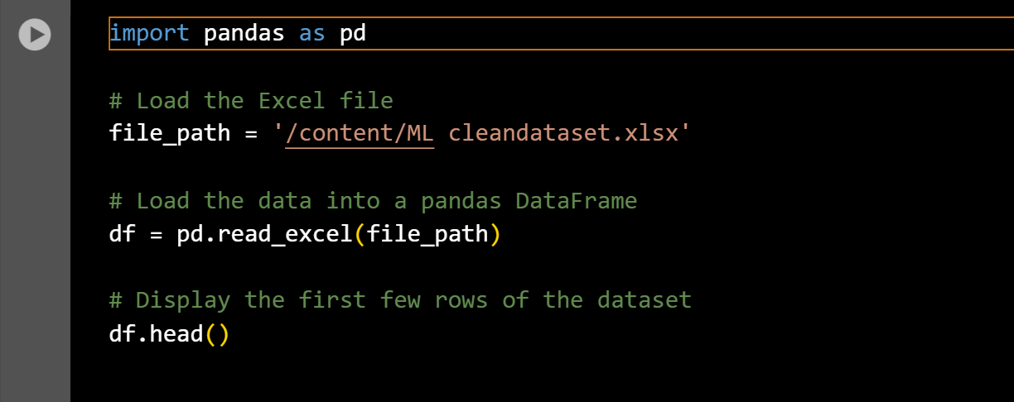
Python was used for data exploration and analysis due to its powerful libraries:
Pandas and NumPy for data manipulation.
Matplotlib and Seaborn for visualizing trends and patterns.

Slide 13
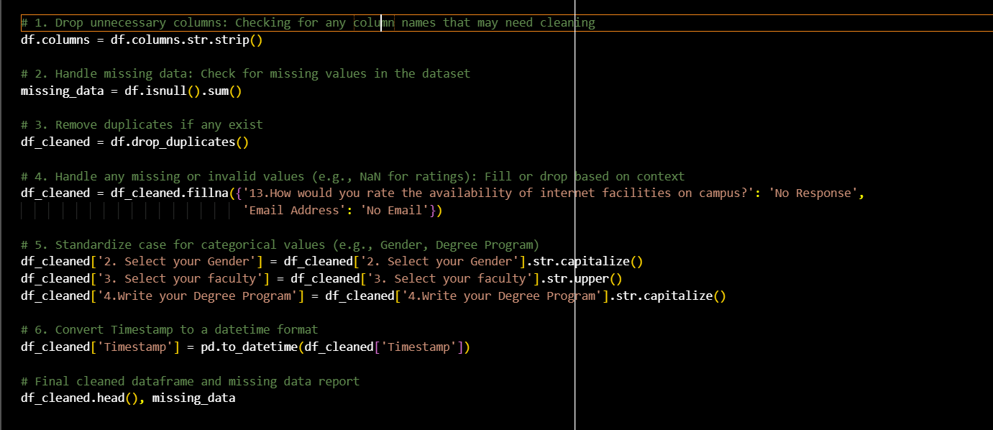
DATA PREPARATION

Slide 14
Modeling techniques
Logistic Regression
Why: This model is ideal if aiming to predict whether a student will recommend a program (Yes/No) based on their satisfaction levels and other factors. It works well with categorical and numerical data, providing interpretable results that help in understanding the factors driving recommendations.
Use case: Predicting if a student is likely to recommend their degree program based on inputs like satisfaction with instruction, resources, and support services.
2. K-Means Clustering
Why: Clustering is useful if we want to group students based on similar responses, allowing to identify clusters of students who share common satisfaction levels or challenges. This helps in segmenting students for targeted improvements.
Use case: Grouping students by satisfaction levels or challenges faced with online learning, so that tailored solutions can be provided to each group.

Slide 15
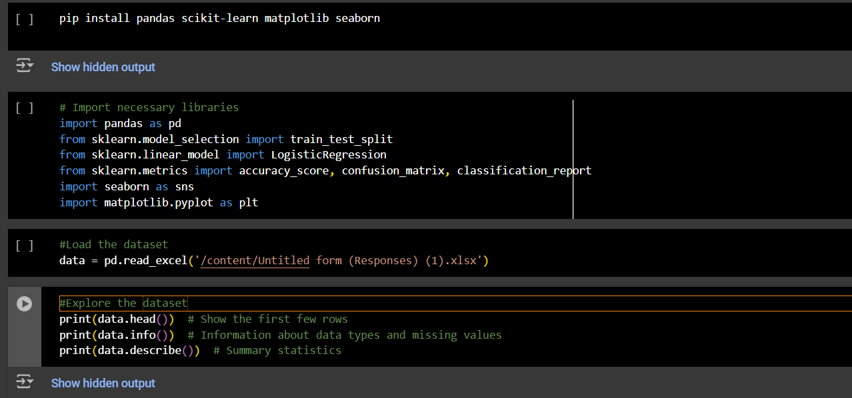
Logistic Regression

Slide 16
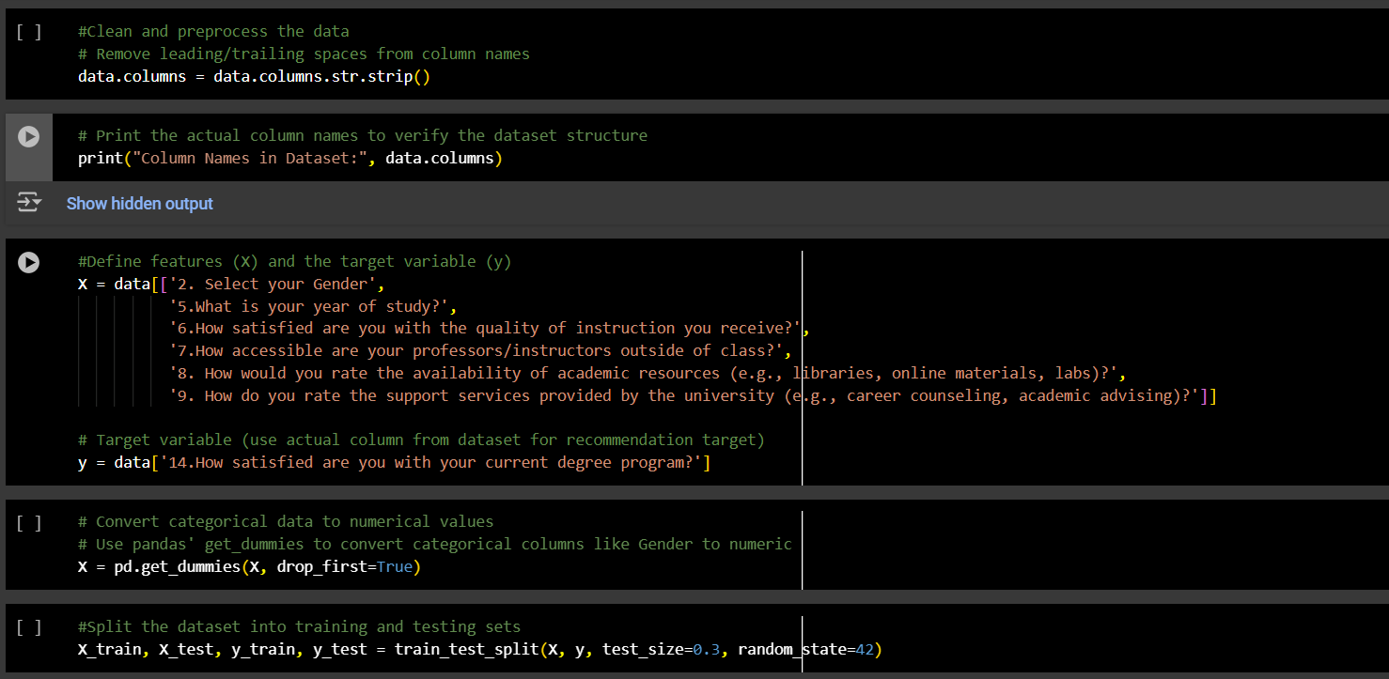

Slide 17
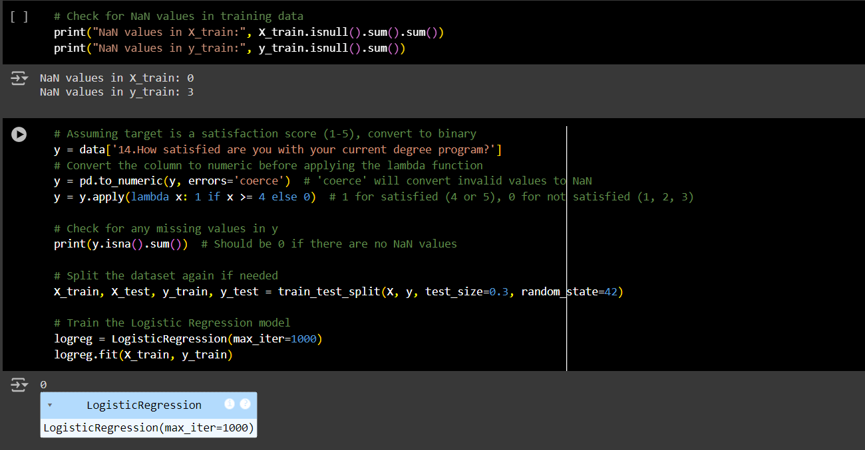

Slide 18
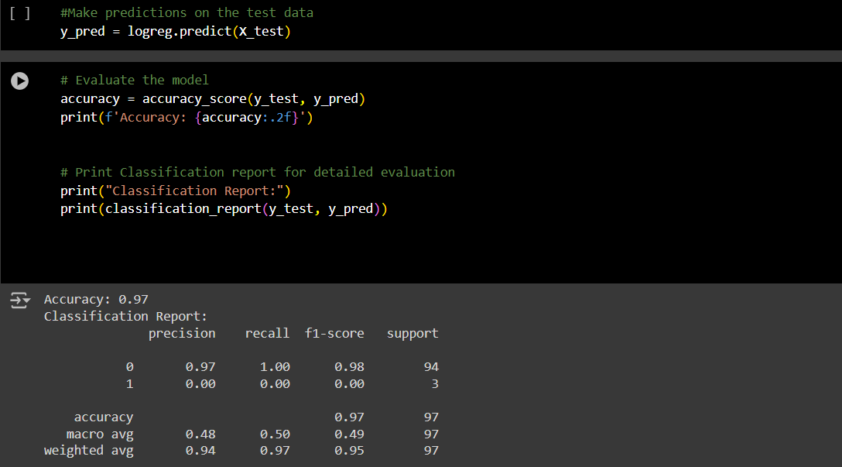

Slide 19

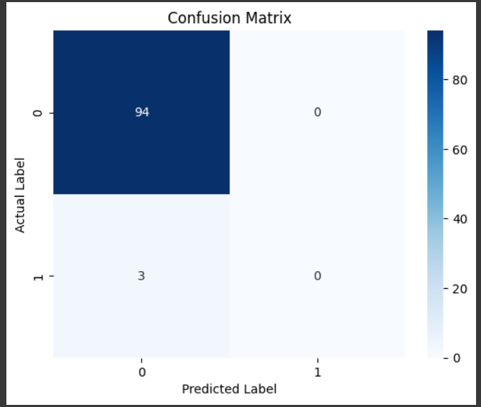

Slide 20

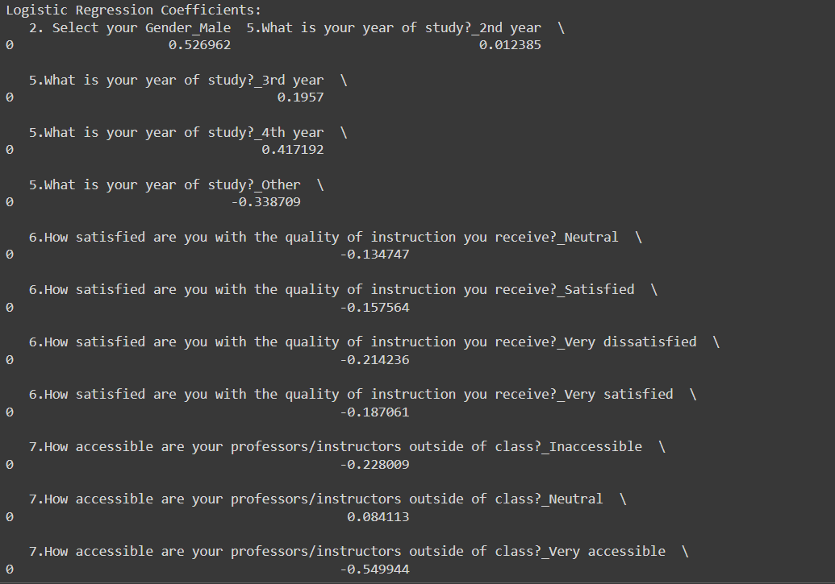

Slide 21
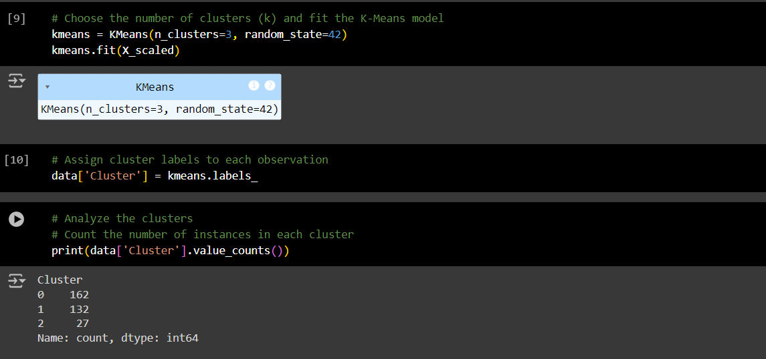
K-means Clustering

Slide 22
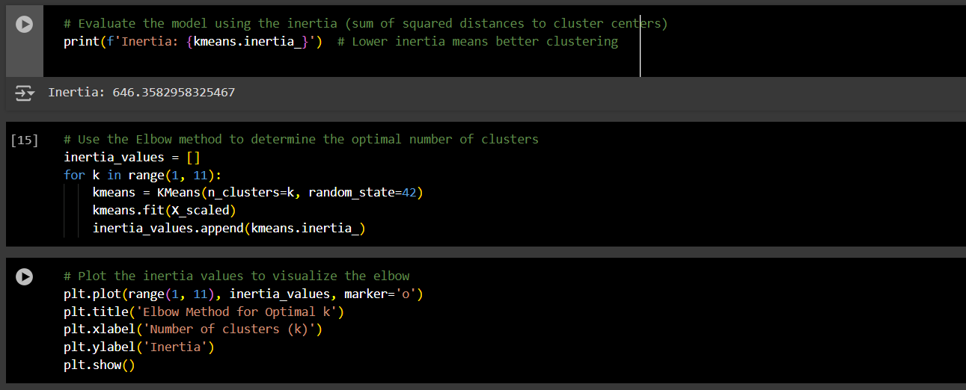

Slide 23
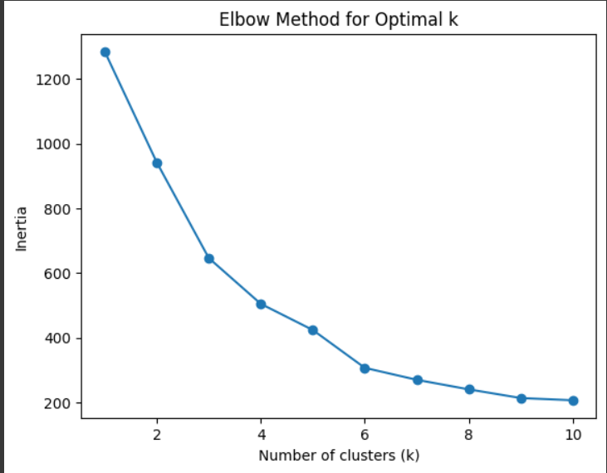

Slide 24
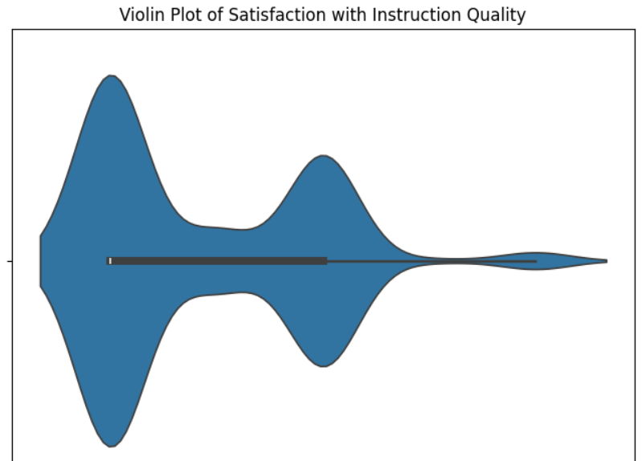
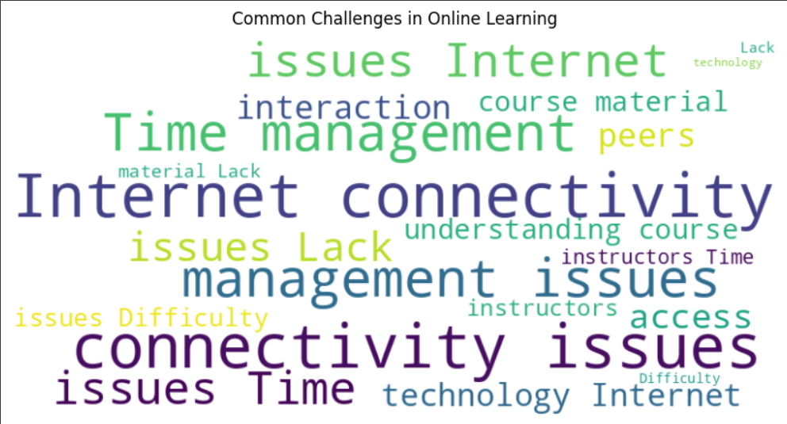
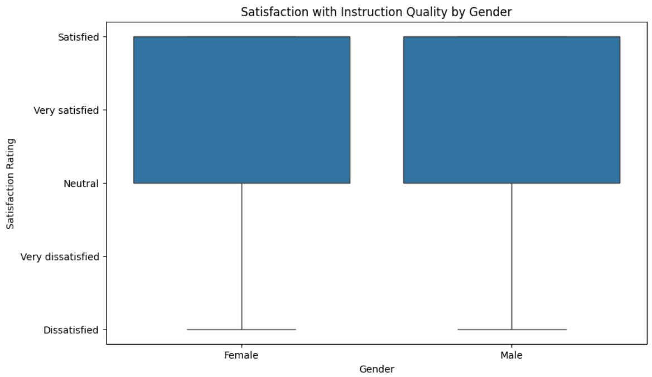
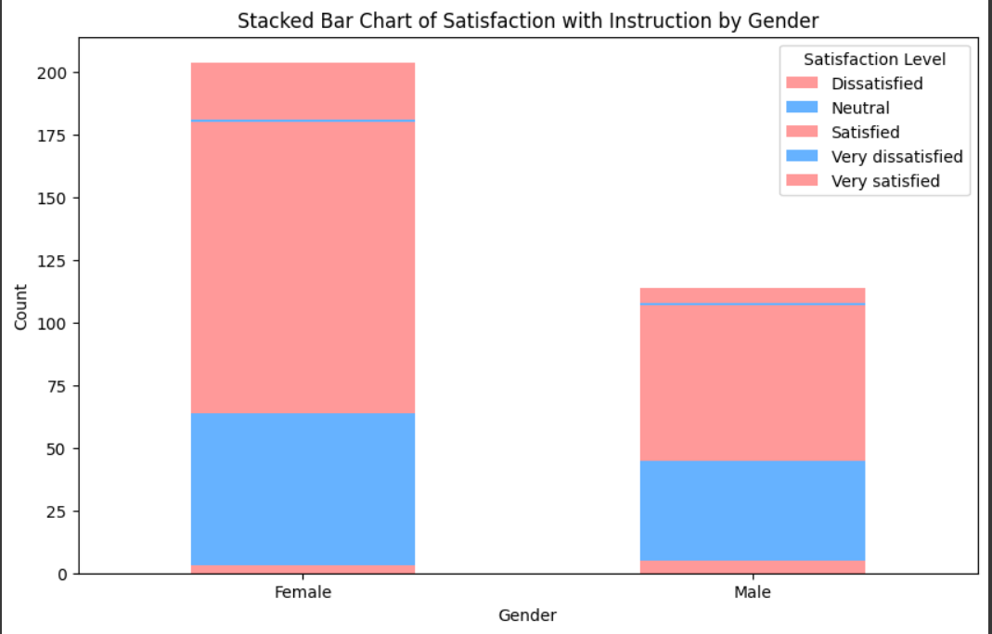
VISUALIZATIONS

Slide 25
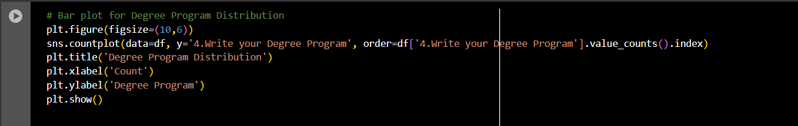
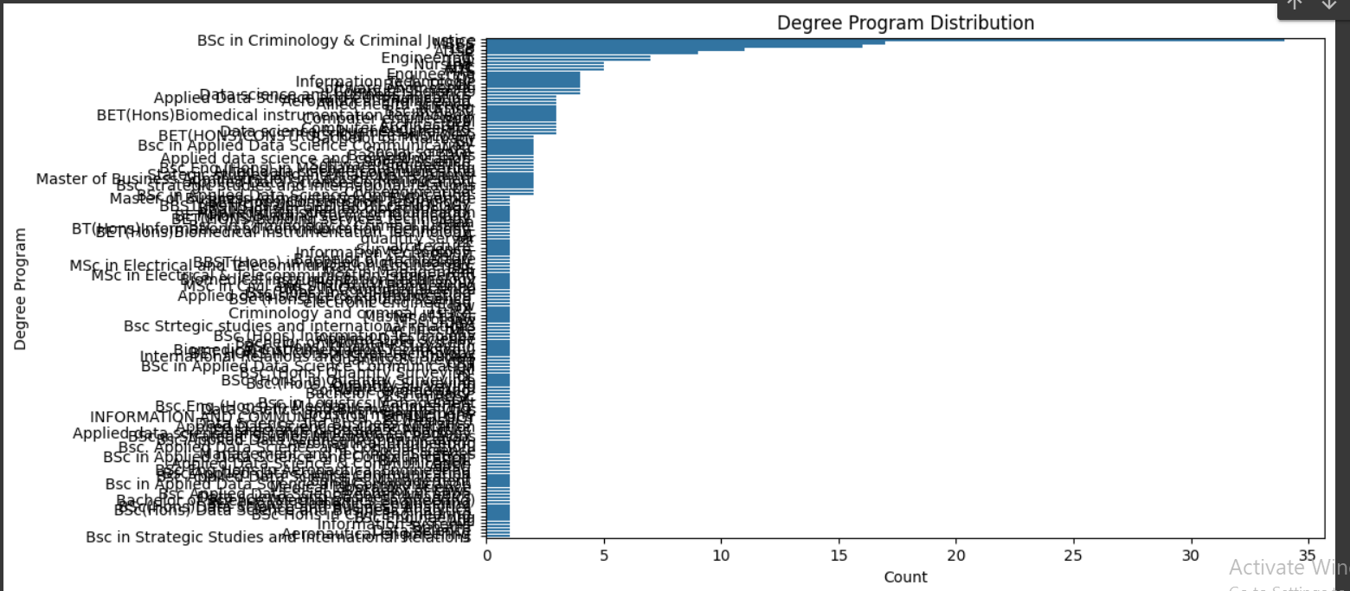
Degree Program Distribution
The BSc in Criminology & Criminal Justice has the highest number of students, with around 35 participants.
Other popular programs include:
Engineering
Information Technology
Applied Data Science Communication
Biomedical Instrumentation

Slide 26
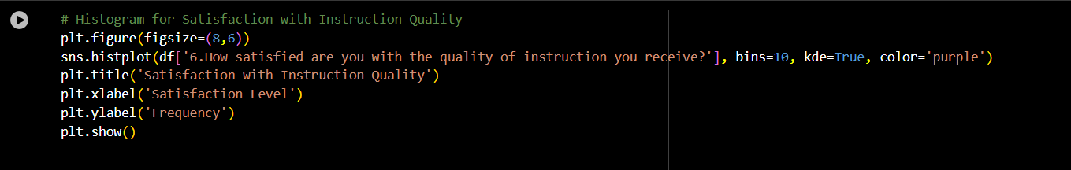
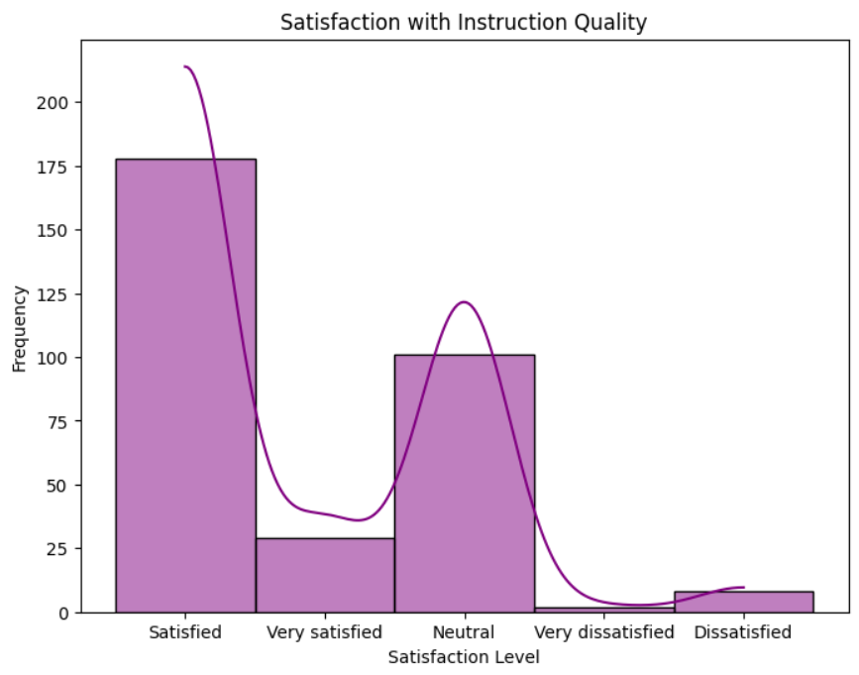
Majority are Satisfied: Over 200 students (the largest group) reported being satisfied with the quality of instruction, indicating overall positive feedback.
Neutral Responses: A significant portion of students are neutral, suggesting indifference or mixed feelings toward the quality of teaching.
Very Satisfied: Only a small number of students reported being very satisfied, showing low levels of extreme satisfaction.
Dissatisfaction: Few students reported being dissatisfied or very dissatisfied, indicating minimal negative feedback
Analysis of Satisfaction with Instruction Quality

Slide 27
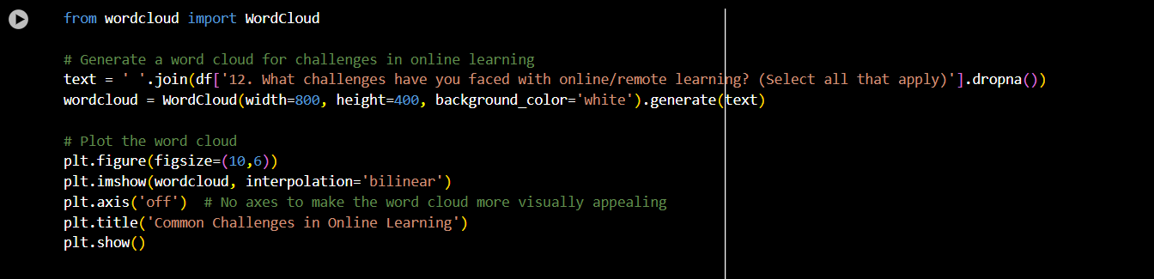
Common Challenges in Online Learning
Internet connectivity issues dominate the challenges faced by many students, This suggests that poor or unreliable internet access is the most significant barrier to effective online learning.
Time management issues Students struggle to manage their time effectively in an online learning environment.
Lack of interaction The difficulty in interacting with peers and instructors is a notable challenge.

Slide 28
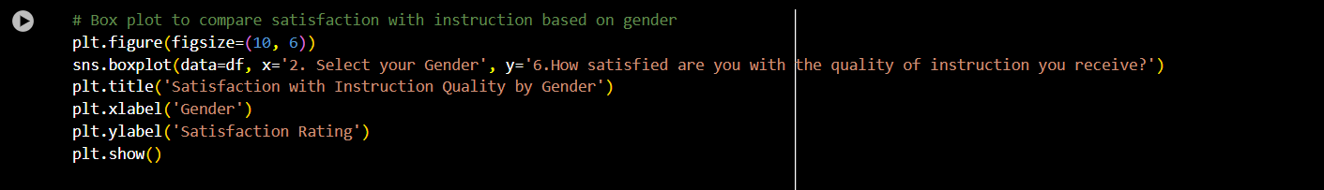
Both males and females show similar satisfaction levels, with most responses falling between “Satisfied” and “Very Satisfied”
The median satisfaction for both gender is “Satisfied”
A small number of responses indicate “Dissatisfied”ratings,but none indicate “Very dissatisfied”
Satisfaction with instruction based on gender

Slide 29
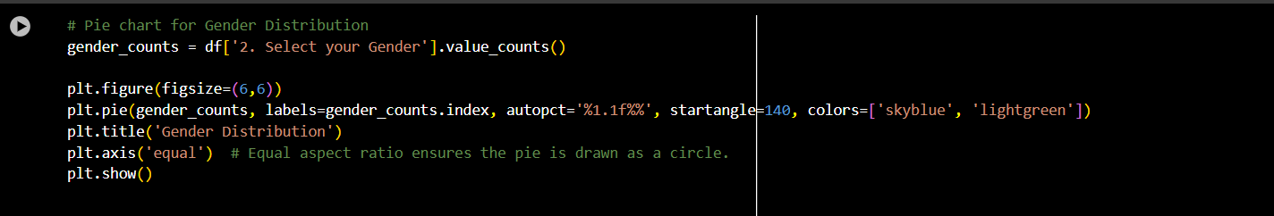
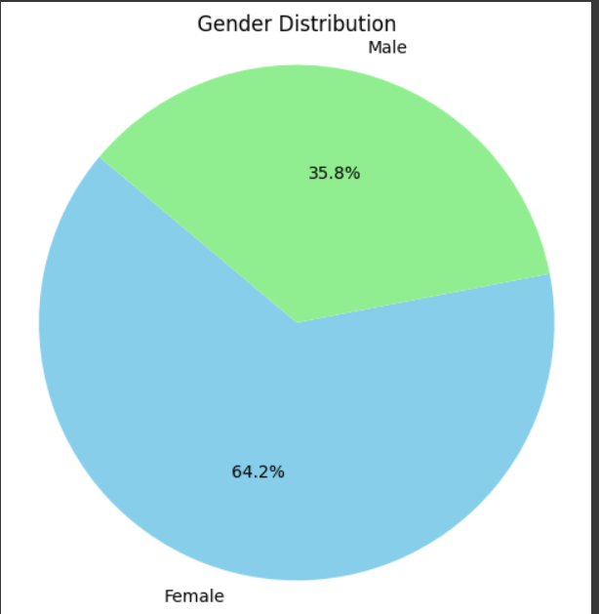
Gender Distribution
64.2% of the participants are female, representing a significant majority.
35.8%of the participants are male, indicating a lower representation compared to females.
The dataset is skewed towards female participants, which could influence the overall survey results.
Any gender-related insights drawn from the data should consider this imbalance to ensure accurate interpretations.

Slide 30

CONCLUSION
Summary of Key Findings
Teaching Quality, Resources, and Support Services These are the most critical factors influencing overall student satisfaction. High-quality instruction, availability of learning resources, and accessible support services drive positive student experiences.
Satisfaction and Program Recommendations Students who report higher levels of satisfaction are significantly more likely to recommend their programs to prospective students, suggesting a strong link between satisfaction and the institution's reputation and growth.

Slide 31
C
O
N
C
L
U
S
I
O
N
Recommendations for Improvement
Invest in Faculty Development
Upgrade Academic Resources and Infrastructure
Enhance Support Services
Expand academic advising to offer personalized guidance to students throughout their academic journey.
Strengthen career counseling services to help students prepare for the job market and postgraduate opportunities.
Provide regular training and workshops to enhance teaching methods.
Encourage faculty to adopt innovative teaching strategies and integrate technology effectively.
Improve access to learning materials by expanding library collections and online resources.
Modernize laboratories and classrooms with state-of-the-art equipment.

Slide 32
CONCLUSION
Impact of Recommendations
Enhanced Reputation
Increased Enrollment
Fostering a Positive Educational Experience
Implementing these improvements will increase student satisfaction, leading to more positive word-of-mouth and stronger program recommendations.
A positive learning environment will attract more students, boosting enrollments and reinforcing KDU’s competitive position.
A supportive and resource-rich environment will ensure students excel academically and develop holistically, contributing to the university’s long-term success.

Slide 33
Recommendations for Future Work
As part of future developments, we propose creating a web portal that will offer educational videos, virtual sessions, and a resource library. The portal will also include an interactive event calendar and a feedback system, enabling users to engage more effectively and provide insights for continuous improvement.
(Webpage link)

Slide 34






Meet Our Team
G
R
O
U
P
N
U
M
B
E
R
04
D/ADC/23/0004
LDSL Renuja
D/ADC/23/0012
SAR Maleesha
D/ADC/23/0020
MG Saranga
D/ADC/23/0020
DSL Nadavi
D/ADC/23/0036
MBSD Fernando
D/ADC/23/0044
HBM Sathsarani

Slide 35
R
E
F
E
R
E
N
C
E
S
Degree Program Recommendations and Student Satisfaction at KDU. Bachelor of Science in Applied Data Science Communication Degree Program, Project Proposal.
Student Satisfaction Survey Data, compiled via Google Forms. https://drive.google.com/drive/folders/1QaljDWUW85y_0Bbr1XebGvVu0TabauTD?usp=sharing

Slide 36
Q & A

Slide 37

THANK YOU

